Slide 1



Optimization of Machine Downtime
Name – Komal Sharma
Email – sharmakomal3017@gmail.com
Phone no. - 9870883200
Current Status – Investing time in myself by learning Data Analytics and seeking opportunities in this field.
LinkedIn URL - My linkedin Profile

Slide 2
Contents
Business Objective
Business Constraints
Project Architecture - Data Flow Diagram
Data Collection
Exploratory Data Analysis
Data Visualization
Notes:
Change

Slide 3
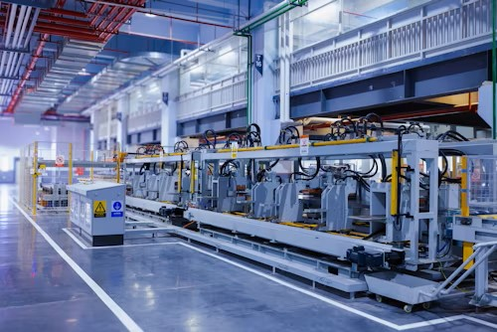
Business Problem
Unplanned machine downtime is causing significant losses in productivity and efficiency within the organization. This unexpected downtime disrupts operations, resulting in delays that impact overall production schedules. The consequences are multifaceted, leading to increased operational costs and diminished output. Addressing this issue is crucial to maintaining a smooth workflow and ensuring that machinery operates at peak performance.
The goal is to implement strategies that not only minimize these disruptions but also enhance predictive maintenance practices, thereby reducing the frequency and impact of such downtime. Achieving this requires a careful balance between minimizing maintenance costs and maximizing equipment efficiency to ensure optimal operational performance.

Slide 4
Project Overview and Scope
In recent years, the issue of unplanned machine downtime has gained increasing attention within industrial sectors due to its significant impact on productivity and cost efficiency. From an extensive review of contemporary research, it is evident that managing machine downtime effectively requires a multi-faceted approach. Various studies highlight that traditional reactive maintenance strategies are often insufficient, leading to higher operational costs and inefficiencies. Research emphasizes the importance of adopting predictive maintenance techniques, which leverage data analytics to forecast potential failures and address them proactively. This project aims to address these challenges by applying advanced data analysis methods to optimize machine downtime and enhance overall equipment effectiveness.
The scope of this project encompasses a comprehensive analysis of machine downtime data to identify patterns and predictors of unplanned failures. By employing statistical and machine learning techniques, the project will develop models to forecast downtime incidents and recommend actionable maintenance strategies. The research highlights several key areas of focus: minimizing downtime through improved predictive maintenance, reducing associated costs by optimizing maintenance schedules, and enhancing equipment performance. Additionally, the project will explore various data sources and analytical tools to ensure that the recommendations are both practical and cost-effective. The ultimate goal is to create a robust framework that not only reduces downtime but also supports long-term operational efficiency and cost management.

Slide 5
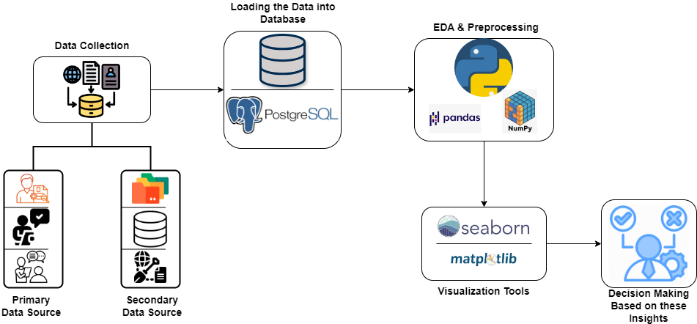
Project Architecture

Slide 6
Data Dictionary
Date → The date on which the machine's data was recorded.
Machine_ID → A unique identifier assigned to each machine.
Assembly_Line_No → The number of the assembly line where the machine is operating.
Hydraulic_Pressure(bar) → Indicating the force applied by the hydraulic components.
Coolant_Pressure(bar) → It helps in maintaining the temperature of the machine.
Air_System_Pressure(bar) → It is important for the functioning of pneumatic components.
Coolant_Temperature → The temperature of the coolant used to regulate machine temperature.
Hydraulic_Oil_Temperature(°C) → The temperature of the hydraulic oil affecting the efficiency of the hydraulic system.
Spindle_Bearing_Temperature(°C) → It impacts machine performance and longevity.
Spindle_Vibration(µm) → The vibration of the spindle indicating potential issues with spindle stability.
Tool_Vibration(µm) → The tool vibration can affect machining quality and tool wear.
Spindle_Speed(RPM) → The rotational speed of the spindle is crucial for machining operations.
Voltage(volts) → The electrical voltage supplied to the machine affects overall machine performance.
Torque(Nm) → Rotational force is essential for understanding the machine’s workload.
Cutting(kN) → The cutting force exerted during machining influences machining efficiency.
Downtime → The duration for which the machine was non-operational, typically due to maintenance or breakdowns.

Slide 7
Exploratory Data Analysis [EDA]
Statistical Insights
Business Insights
Among the 12 numerical columns analyzed, only 6 columns (Hydraulic Pressure, Coolant Pressure, Coolant Temperature, Spindle Speed, Torque, Cutting) have been identified as having a significant impact on machine failures.
Within the defined operational ranges, there are 1,185 *instances where no machine failure was observed and *1,098 instances where machine failure occurred.
There are 217 instances where the operational parameters fall outside the defined ranges.
Out of the 217 cases outside the defined ranges, 113 cases (10.29% of machine failure cases) have the potential to be converted into "No Machine Failure" scenarios if the parameters are brought within the defined operational ranges.
The analysis identifies 6 key parameters that significantly impact machine failures. By focusing maintenance and monitoring efforts on these parameters, the business can proactively prevent machine failures and optimize operations.
By maintaining the operational parameters within the defined ranges the business can potentially reduce machine downtime by 10.29%.
By prioritizing the monitoring and maintenance of the 6 critical parameters, the business can optimize resource allocation, reduce maintenance costs, and extend the lifespan of equipment.
By minimizing downtime, the business can meet production targets more consistently, maintain customer satisfaction, and strengthen its competitive position in the market.
Notes:
EDA is used for seeing what the data can tell us before the modeling task.
Change

Slide 8
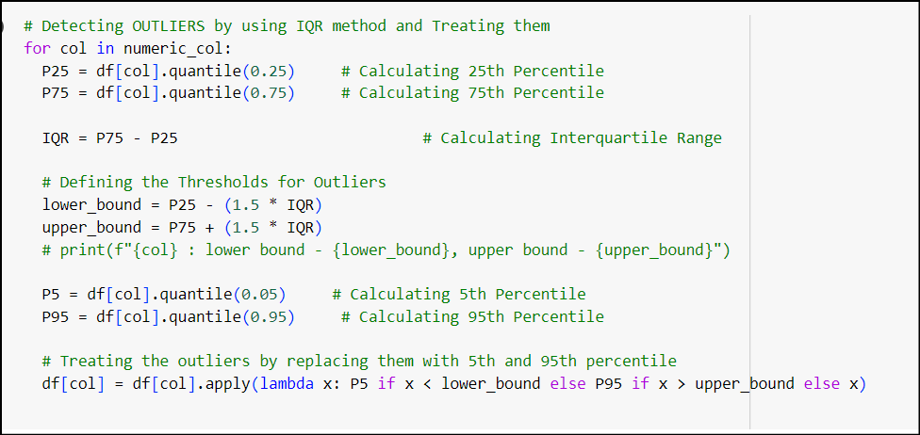
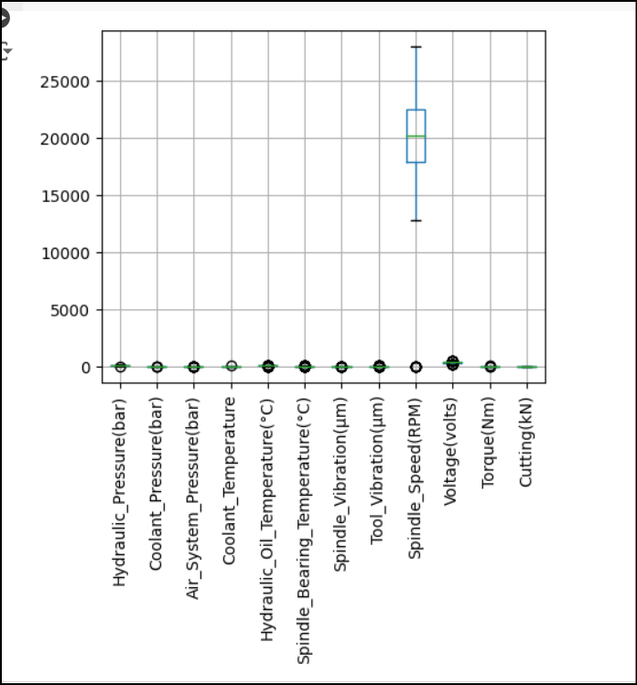
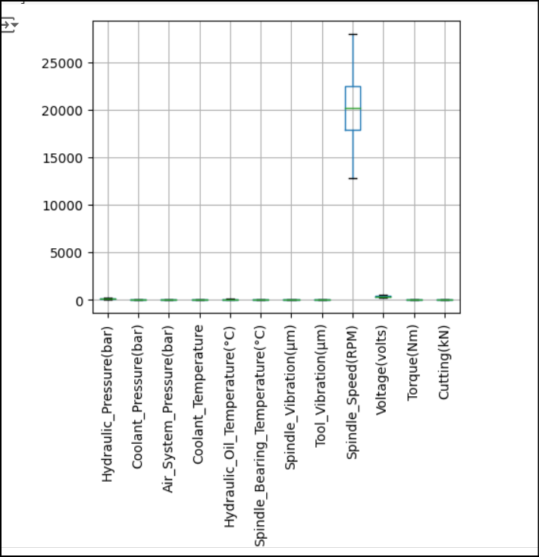
Data Preprocessing
In the preprocessing phase, various data cleaning techniques were employed to ensure the quality and reliability of the dataset. The following steps were taken:
Duplicate Values: The dataset was scanned for duplicate entries to ensure data accuracy.
Handling Null Values: The dataset was checked for any missing or null values. These missing values were addressed by replacing them with the mean of the respective columns. This approach ensures that the missing data does not distort the overall analysis while maintaining the statistical integrity of the dataset.
Four Moments of Business Decisions: The dataset underwent statistical analysis by calculating the four moments—mean, median, mode, variance, standard deviation, skewness, and kurtosis—to understand its distribution. This provided a deeper insight into the data's central tendency, variability, and shape, laying the foundation for more advanced analysis.
Outlier Detection and Handling: Outliers were identified using the Interquartile Range (IQR) method and visualized through box plots. The identified outliers were handled appropriately using the same IQR method, which helps in retaining the most critical data points while mitigating the influence of extreme values [see picture (a) and (b)].
(a)
(b) Outliers Before & After the Treatment
Notes:
Keep observations

Slide 9
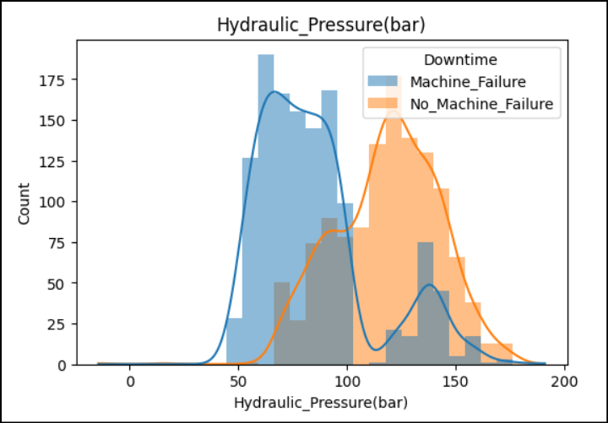
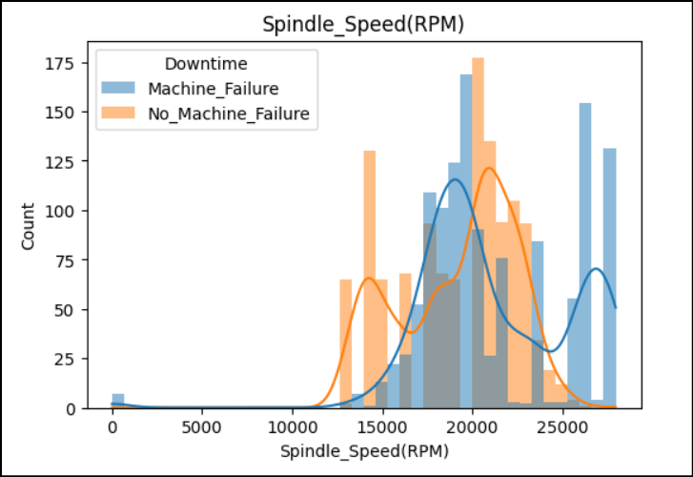
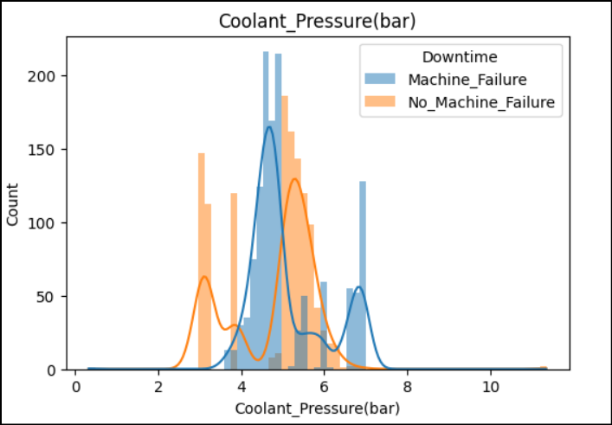
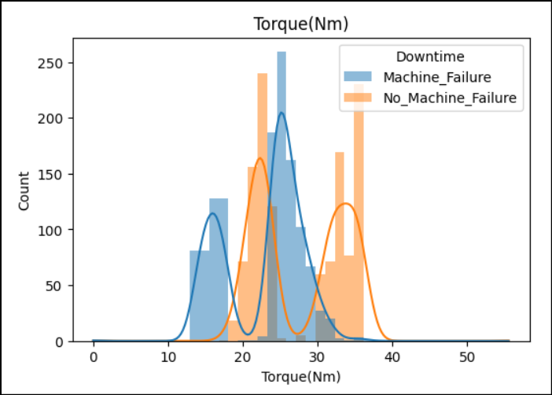
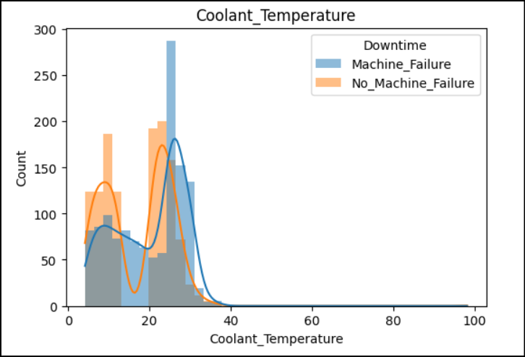
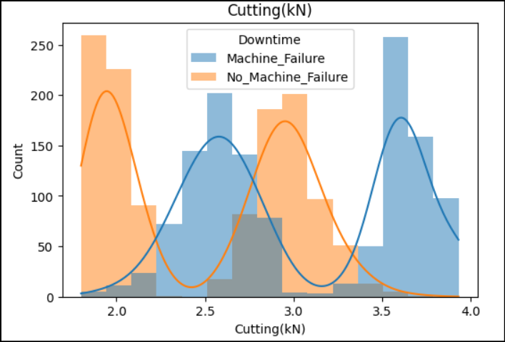
Data Visualization
Hydraulic Pressure:- Maintaining hydraulic pressure within the optimal range reduces machine failures, as deviations lead to increased downtime.
Coolant Pressure:- Consistent coolant pressure within defined limits minimizes downtime, with fluctuations linked to higher failure rates.
Coolant Temperature:- Keeping coolant temperature stable within the ideal range prevents machine failures, as extremes increase downtime.
Spindle Speed:- Operating spindle speed within target RPM ranges decreases downtime, with outliers contributing to failures.
Torque:- Proper torque management within the specified range is crucial to reduce machine failures and associated downtime.
Cutting:- Controlling cutting force within the defined limits minimizes failures and optimizes machine performance.
Notes:
Add graphical

Slide 10
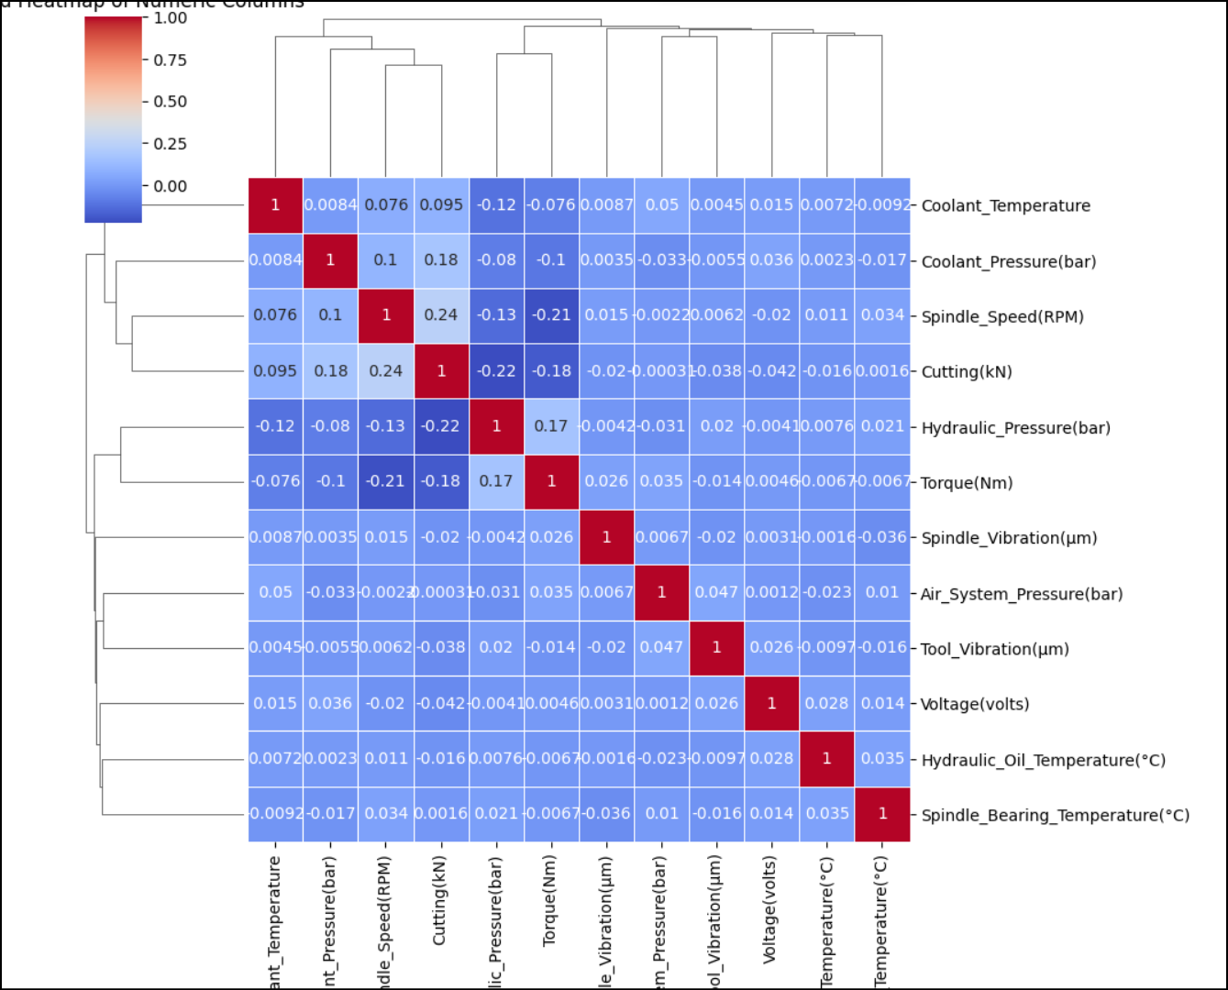
Data Visualization
The clustered heatmap visually emphasizes the relationships between the 12 numeric columns, with a clear indication of how the 6 key parameters—Hydraulic Pressure, Coolant Pressure, Coolant Temperature, Spindle Speed, Torque, and Cutting—are strongly correlated with machine downtime. This clustering highlights the significant impact these factors have on machine performance, making them critical targets for optimization efforts to reduce machine failures.
Clustered Heatmap for all the Numeric Columns
Notes:
Add graphical

Slide 11


